Slide 1
Eningo

Slide 2
Main work streams / projects
Vectorisation / QGIS (Code and Deployment) - Python dev and Devops
Multi tenancy project – Python, React, Mobile app
Bugs/ Prod Issues and Improvements on existing code

Slide 3

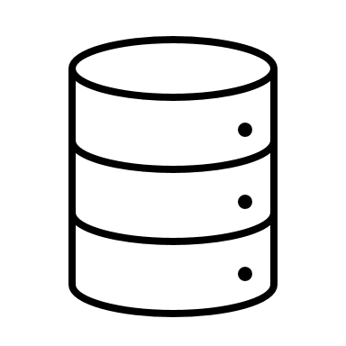

Multitenancy Project
Web / Mobile
Tenant 1
Fetch Config from DB
Call API's using config data
Tenant 2
Call API's using config data
Fetch Config from DB
Eningo - LK API calls to Fetch data
Users- Tenant 1
Users- Tenant 2
Send data to be saved
Centralised DB
Node / Server
The Node / Program will fetch the tenant config from database for all clients.
Any new client, the data needs to be added manually into DB for now
Holds the Identity Info like Uid / Pwd / Org Id
Pass Org Id and fetch data
Centralised DB
Identity DB

Slide 4
Pros and Cons
Pros
Easy maintenance and Deployment
Common downtime for all tenants for Maintenace and deployment of updates
Cons
If centralised Db security is compromised, then we will loose all data, so need daily backup plans in place
If centralised Node / IP or DB goes down, all Tenants are affected. So you need to have load balanced environment.
Load balancing the front-end server / Nodes will give you multiple benefits like – High availability, better performance and no risk of single point failure

Slide 5
Multitenancy Project
Web / Mobile
Tenant 1
Fetch Config from DB
Call API's using config data
Tenant 2
Call API's using config data
Fetch Config from DB
Eningo - LK API calls to Fetch data
Users- Tenant 1
Users- Tenant 2
Tenant 1 DB
Tenant 1 DB
Send data to be saved to Tenant DB
Node / Server
Send data to be saved to Tenant DB
Tenant 2
DB
Pass Org Id and fetch data
Tenant 2 DB
Holds the Identity Info like Uid / Pwd / Org Id
Identity DB
The Node / Program will fetch the tenant config from database for all clients.
Any new client, the data needs to be added manually into DB for now

Slide 6
Pros and Cons
Pros
Each tenant has its own Db, so data is more segregated and secured
Maintenance activity on one DB will not effect another.
But we have to consider that right now, our app is not DB heavy, so do we need to have this segregation?
Cons
Extra overhead for Front end server to check which DB to access for each tenant
Maintenance of multiple DB's for each client
High availability of DB servers for each client if the front end is also load balanced

Slide 7
Vectorization/ qgis
Packaging and deployment of the qgis code - devops
Any code improvements on the existing code

Slide 8
Bugs /Production issues/ general Improvements
Pipelines / Automated scripts for deployment
Improvements in the email templates
Improvements on the admin dashboard
Any production issues / bugs or new client on-boarding will be considered priority over the other work streams

Slide 9
Resources
Python Dev- 1 dev ( 2 weeks)
If rewriting solution – Typescript ( 2-3 weeks)
React/ Front end Dev- 1 dev ( 2 weeks)
Devops – 1 devops(3-4 weeks)
Mobile / General Dev – Need basis for ongoing work
QGIS - Need 1-2 weeks to identify

